Slide 1
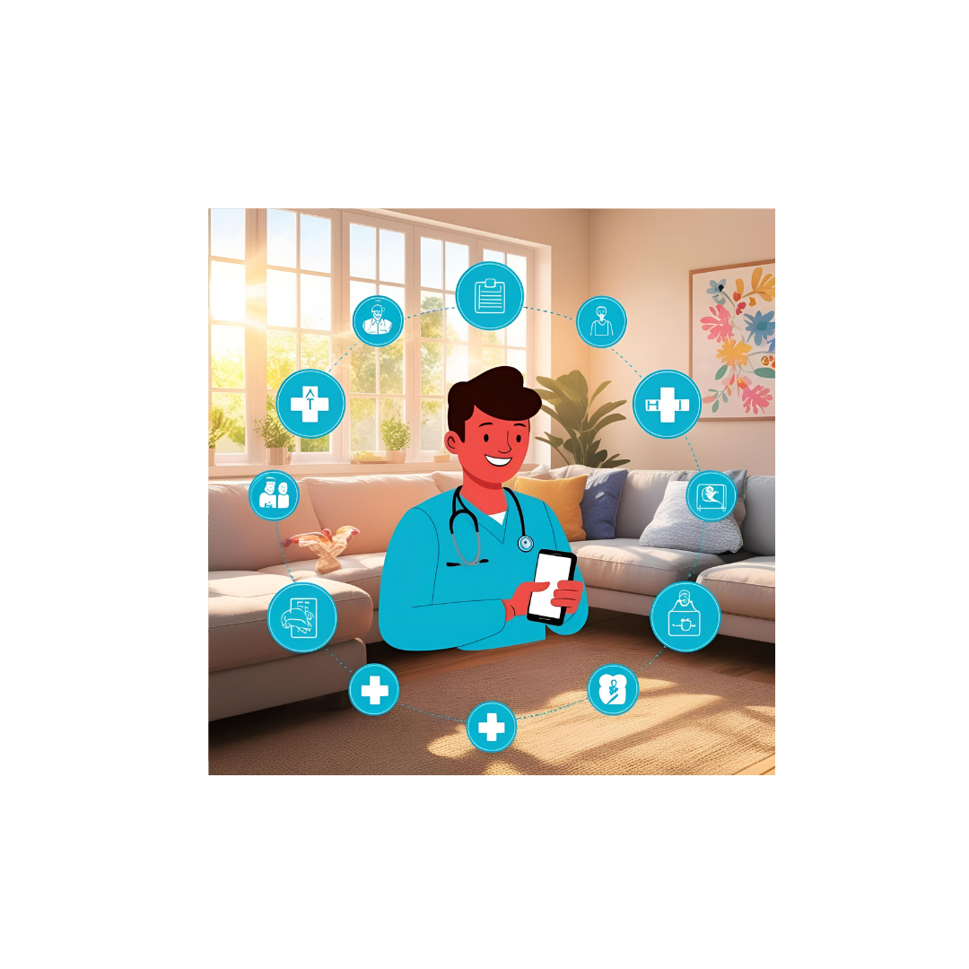
(2305260005)Ashutosh Mohanty (2305260001)Abhijit Badapanda (2305260012)Mukesh Kalo
Medi-Track
MCA 4th Semester

Slide 2
Introduction to Medi-Track
The Medi-Track project is a digital healthcare platform designed to enhance the efficiency and accessibility of medical services by providing an simple doctor appointment booking system, specialization-based matching support. Advanced security measures ensure compliance with healthcare regulations like HIPAA and GDPR, safeguarding sensitive medical data. By incorporating the system enables remote consultations, reducing wait times and improving healthcare access, especially in remote areas. The Medi-Track project aims to modernize healthcare delivery through seamless digital solutions, making medical services more efficient, secure, and patient-centric.

Slide 3
Contents
1.Objective
2.Key Features
3.System Requirement
4.Tools and Technology
5.Benifits
6.ER Diagram
7.User roles( Patient ,Doctor , Admin)
8.Screenshot of Medi -track
9.Future Enhancements
10.Challenges and solution
11.Security features
12.Conclusion

Slide 4
Objectives of the Project
Efficient Appointment Management – Enable patients to book, reschedule, or cancel doctor appointments seamlessly through an integrated digital platform.
Specialized Doctor Search – Allow users to find doctors based on their specialization, availability, and expertise for better healthcare decisions.
Enhanced Patient Experience – Improve user convenience by providing real-time appointment tracking, notifications, and reminders.

Slide 5
Key Features
Online Doctor Appointment Booking – Patients can easily search for doctors, view their availability, and book appointments in real-time.
Doctor Specialization Filtering – Users can find doctors based on their specialization and experience for better decision-making.
Admin Dashboard & Analytics – Provides insights into appointment trends, doctor performance, and system efficiency for better management.
Feedback & Review System – Patients can leave reviews for doctors, helping others make informed choices.

Slide 6
SYSTEM REQUIREMENTS
Hardware Requirements
Display: 1920x1080 resolution Monitor.
Processor: Intel Core i5 or higher.
Network: Internet connectivity or Wi-Fi.
Storage: At least 256GB SSD.
RAM: 8GB or higher.
Software Requirements
Visual Studio Code.
Git
My SQL
XAMPP

Slide 7
TOOLS AND TECHNOLOGY
HTML
Hyper Text Mark-up Language is used for developing front-end Graphical user interface. It is standard language used for web pages.
CSS
Cascading style sheets are a style sheet language used to show a document or content written in mark-up language.
SPRING BOOT
Spring Boot is a Java framework that makes it easier to create and run Java applications. It simplifies the configuration and setup process, allowing developers to focus more on writing code for their applications.

Slide 8
JAVA
Java is a class-based, object-oriented programming language that is designed to have as few implementation dependencies as possible. It is intended to let application developers Write Once and Run Anywhere (WORA), meaning that compiled Java code can run on all platforms that support Java without the need for recompilation.
MYSQL
For database MYSQL is used. This technology will ensure that the software is scalable, reliable, and secure.
THYMELEAF
Thymeleaf is a powerful, clean, and flexible tool that makes it easy to build modern Java-based web applications — especially when you're using Spring Boot.

Slide 9
Convenient Appointment Scheduling – Patients can book, reschedule, or cancel appointments anytime, reducing wait times.
Easy Access to Specialists – Users can find doctors based on specialization, location, and availability, ensuring better healthcare choices.
Improved Patient Experience – Automated notifications, reminders, and real-time updates enhance user satisfaction. Scalable & Future-Ready – Easily integrates with advanced healthcare technologies like AI, IoT, and wearable devices.
Benefits

Slide 10
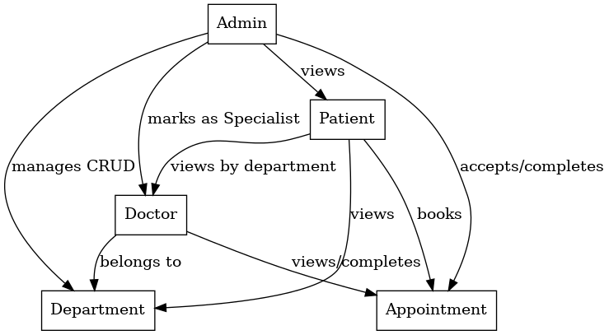
ER Diagram

Slide 11
User Roles (Patients, Doctors, Admin)
Admin
Perform CRUD operations on Departments.
View all Doctors, Appointments, and Patients.
Mark a Doctor as a Specialist.
Update Profile.
Check Appointments and mark them as Completed.

Slide 12
Doctor
View Appointments.
Update Profile.
Mark Appointment as Completed.

Slide 13
Client
Book an Appointment.
View Departments.
View Doctors.
View Doctors by Department.

Slide 14
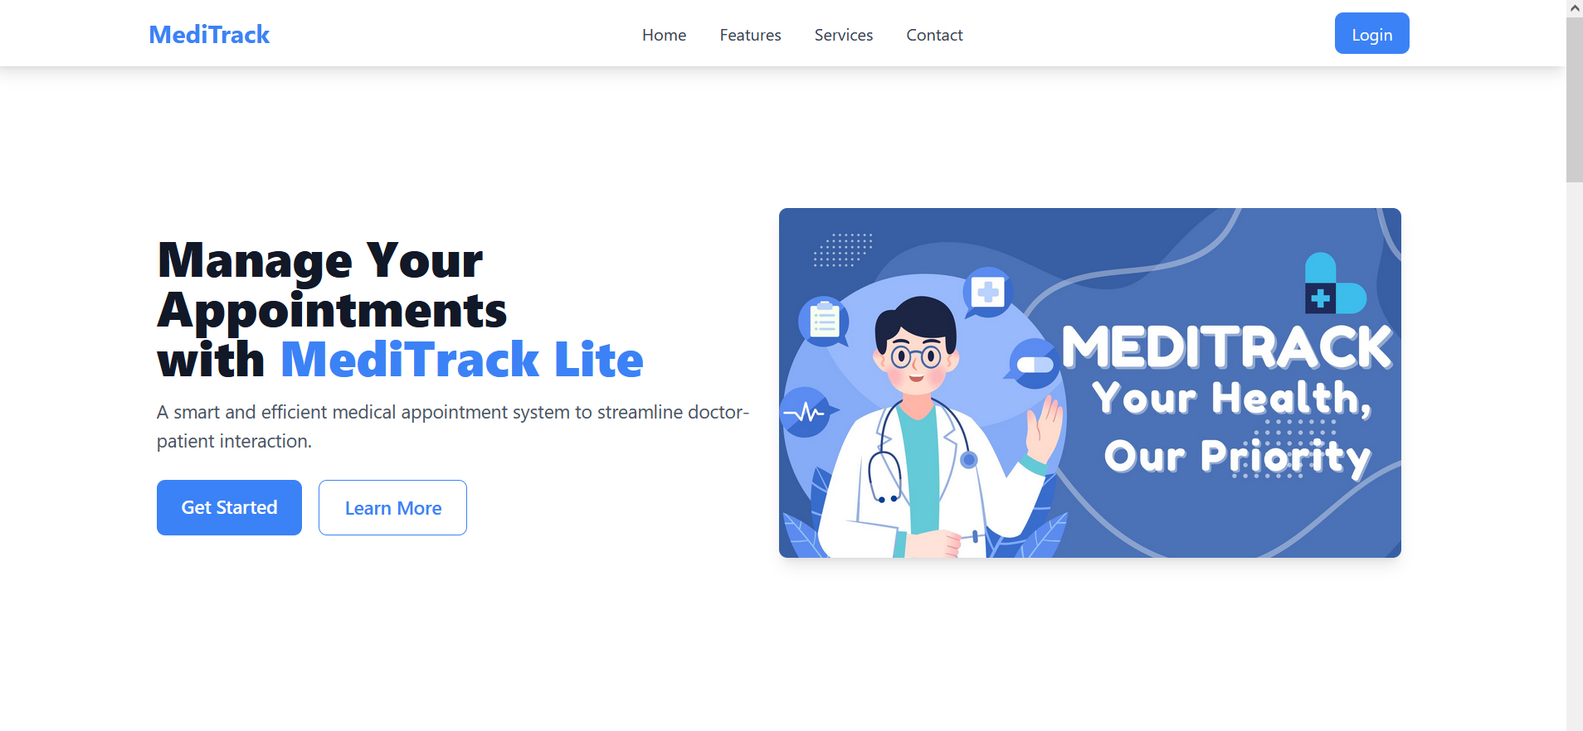
Landing Page

Slide 15
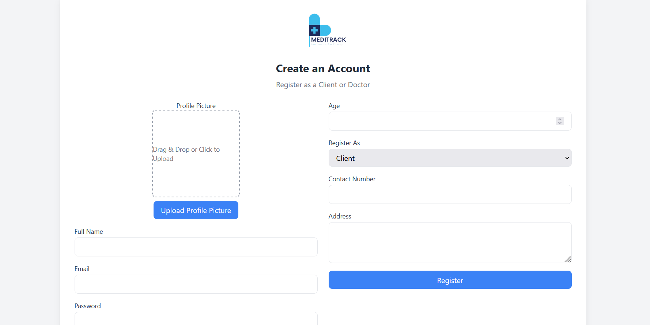
Register as a client or Doctor

Slide 16
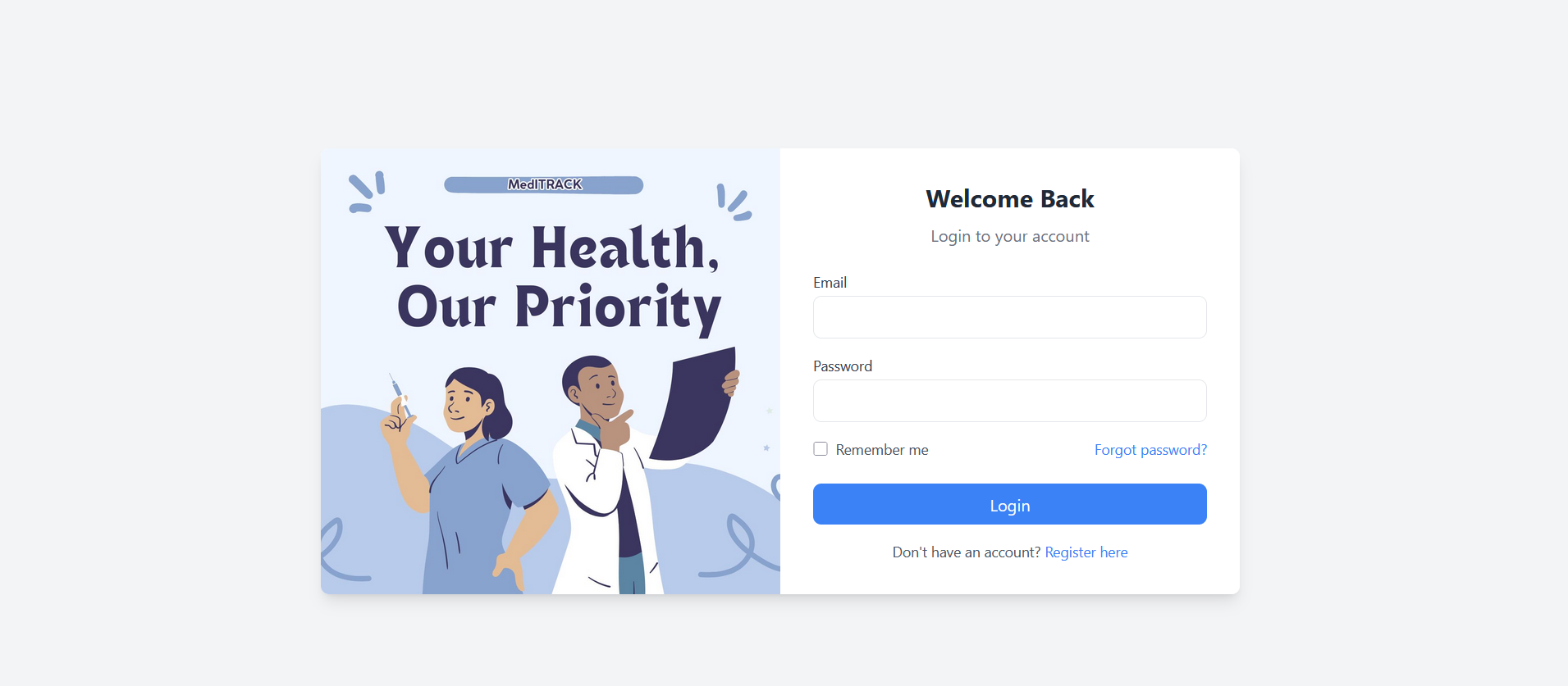
Log in Page

Slide 17
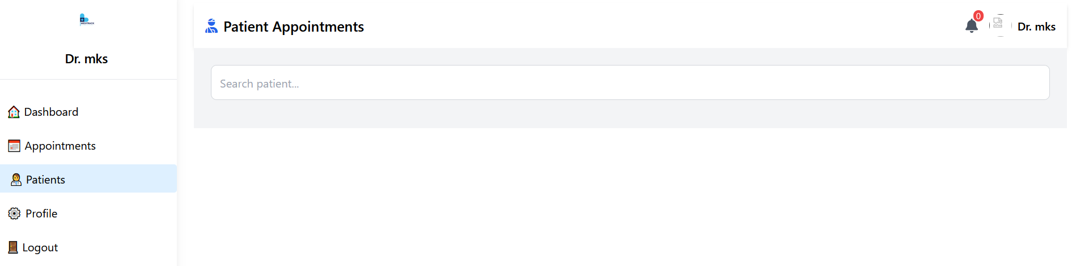
Doctor Panel (Patient Appointments)

Slide 18
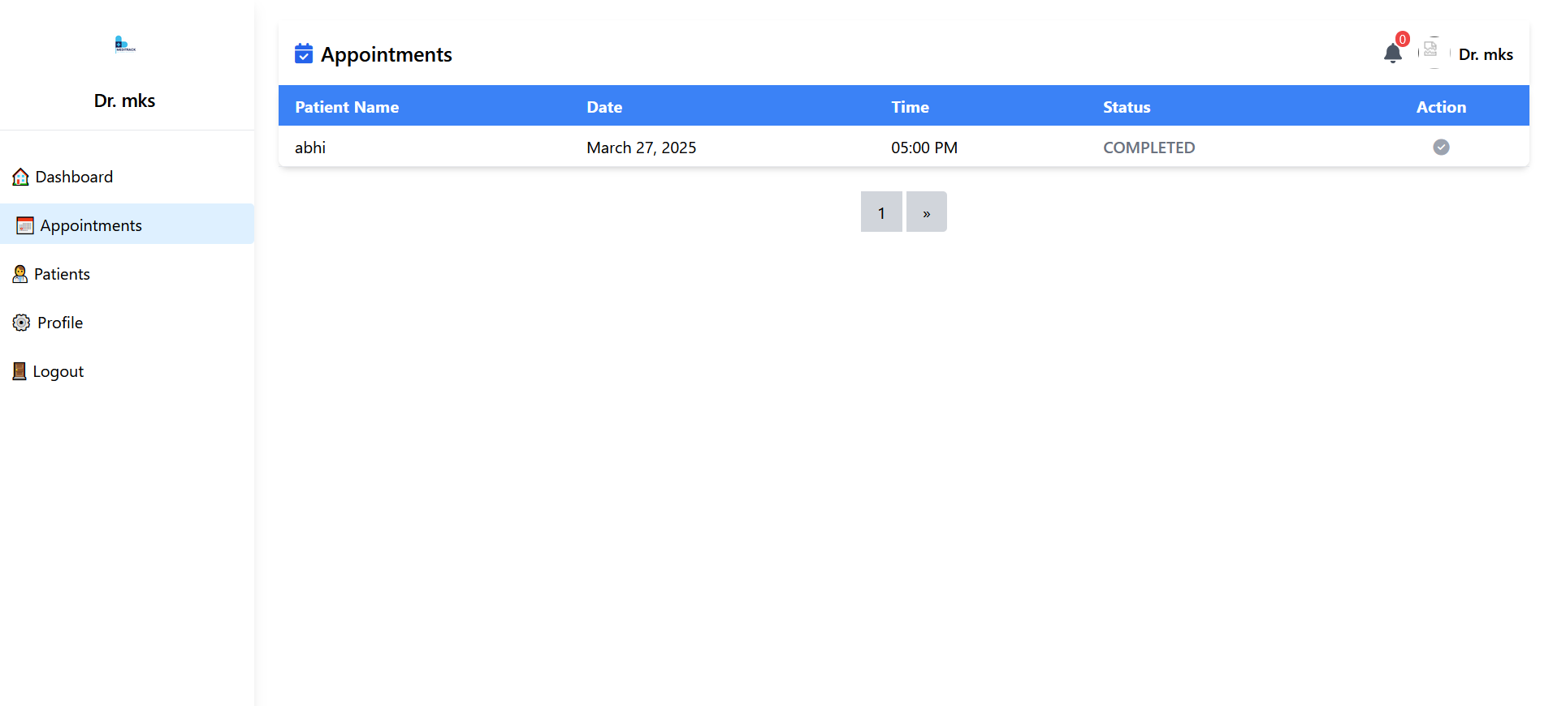
Doctor Appointment Page

Slide 19
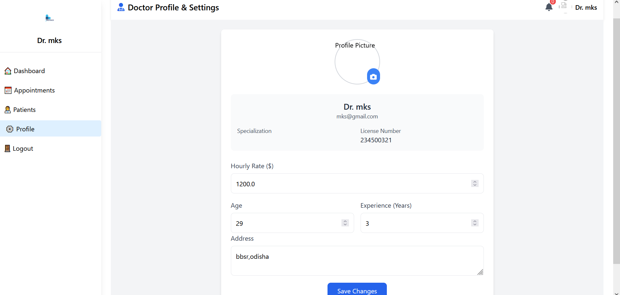
Doctor Profile and Settings Page

Slide 20
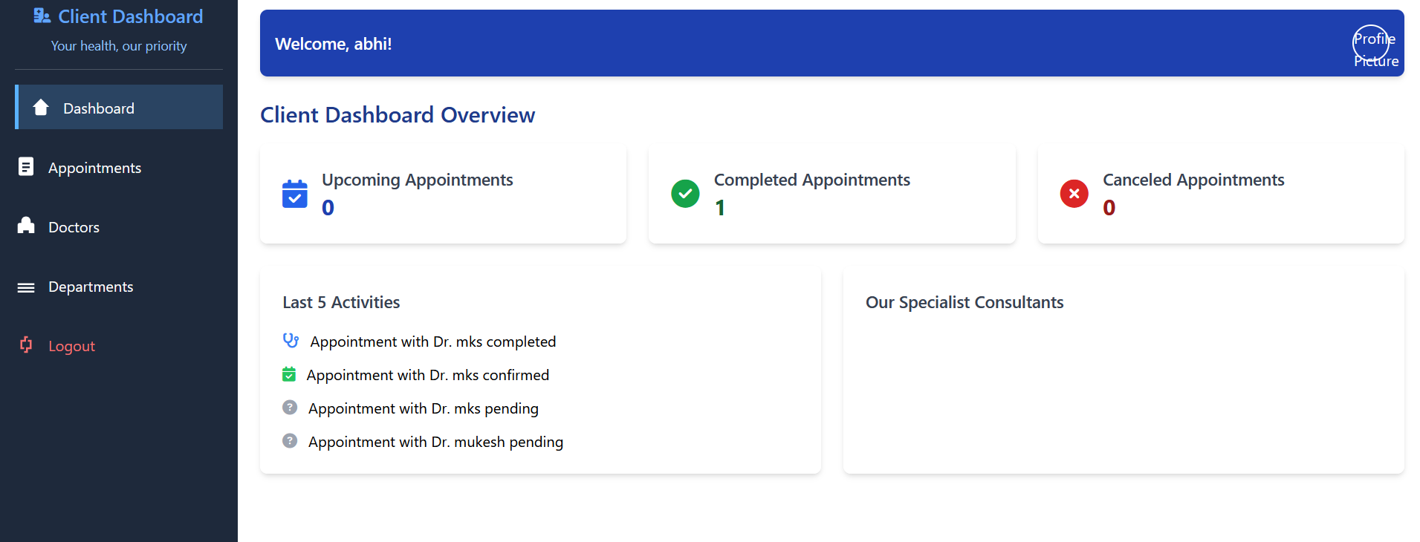
Client Dashboard Page

Slide 21
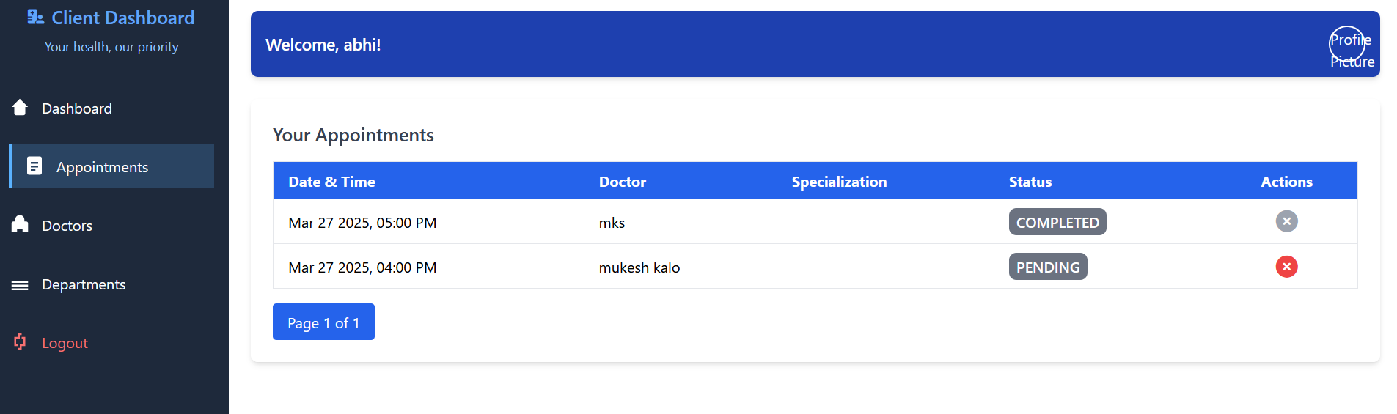
Client Appointments Page

Slide 22
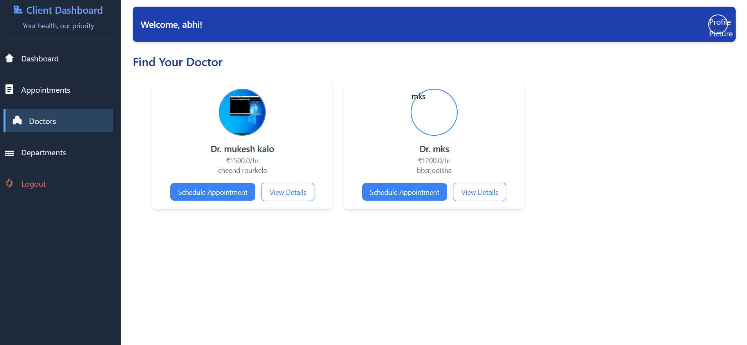
Find Your Doctors page

Slide 23
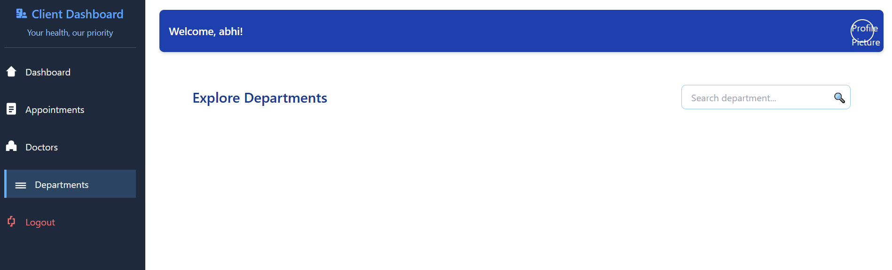
Departments Page

Slide 24
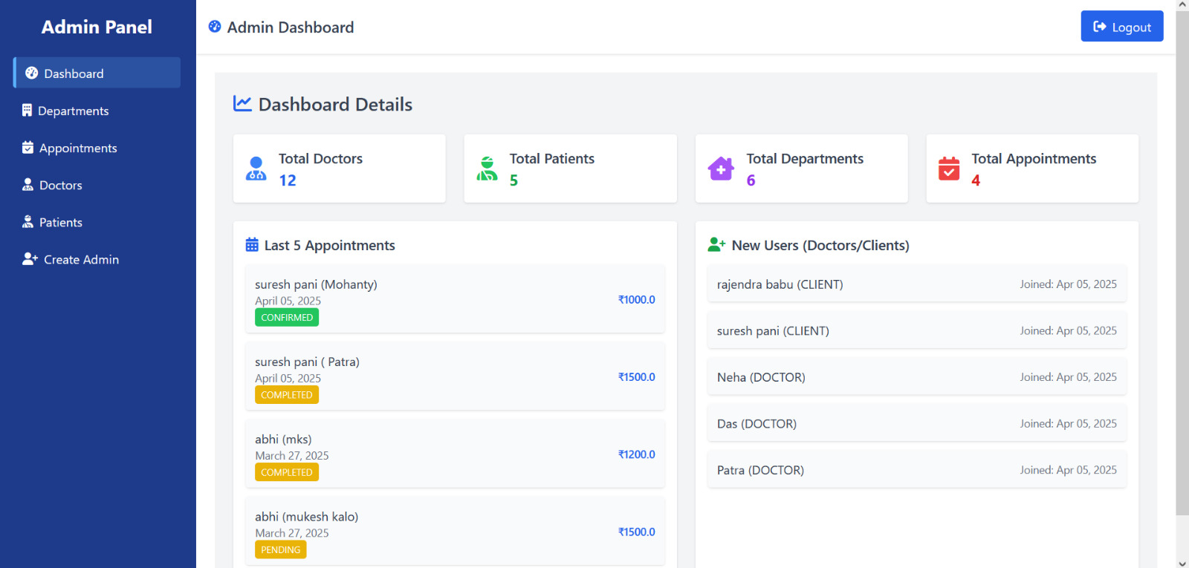
Admin Panel (Dashboard)

Slide 25
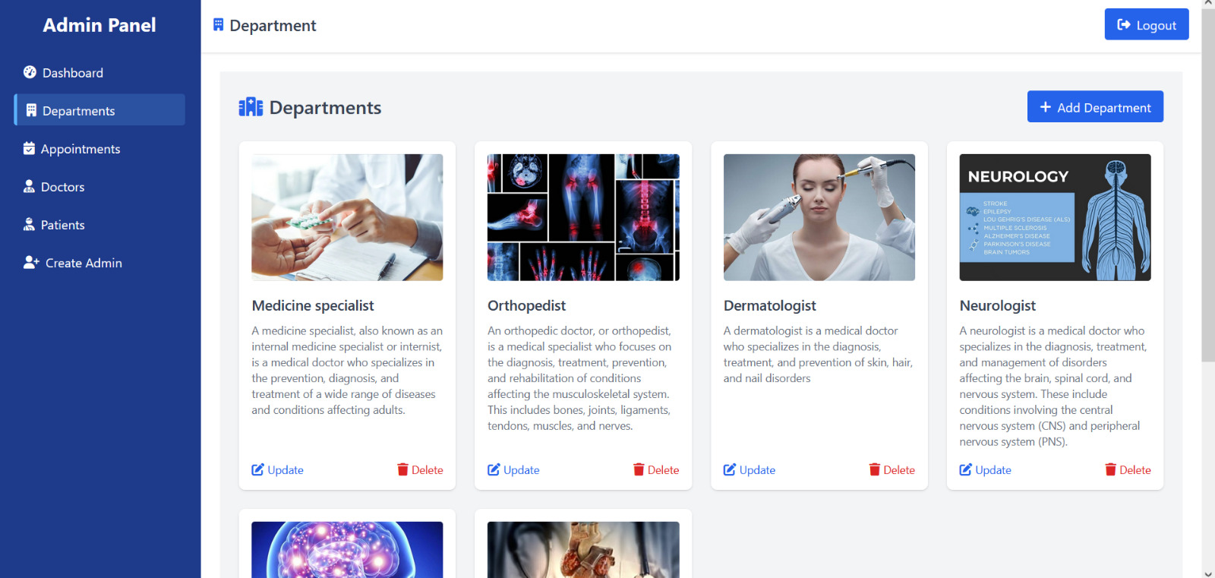
Admin Panel (departments)

Slide 26
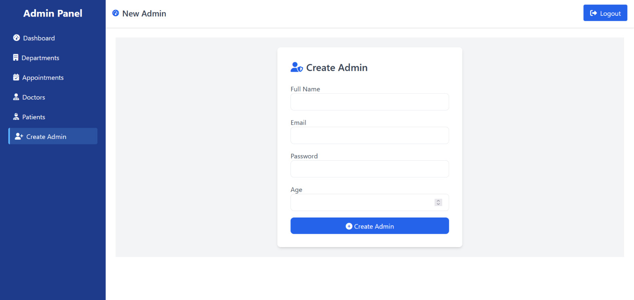
Admin Pannel (Create Admin)

Slide 27
Future Enhancement
AI-Powered Diagnosis & Predictive Analytics
IoT-Based Health Monitoring
Blockchain for Secure Medical Records
VR-Based Telemedicine
Multilingual AI Chatbots

Slide 28
Challenges and Solution
1. Data Security & Privacy
Issue: Handling sensitive patient records securely while complying with healthcare regulations.
Solution: Implement encryption, multi-factor authentication (MFA), and compliance with data privacy laws (HIPAA, GDPR).
2. Challenge: System Scalability & Performance
Issue: High traffic can slow down the platform, affecting user experience.
Solution: Use cloud-based solutions, load balancing, and optimized database management.
3. Challenge: Doctor Availability & Scheduling Conflicts
Issue: Managing real-time doctor availability across multiple locations.
Solution: Smart scheduling with AI-driven recommendations and buffer time slots to reduce conflicts.

Slide 29
Security Features
1.CSRF(Cross Site Request Forgery)
2.SQL injection
3. Bcrypt Encryption

Slide 30
Conclusion
The Medi-Track project provides a secure and efficient platform for managing healthcare services, including doctor appointments, specialization-based doctor selection, and patient record tracking. By allowing patients to book appointments with specialists based on their medical needs, the system ensures better accessibility to quality healthcare. With strong security measures like encryption, CSRF protection, and SQL injection prevention, Medi-Track safeguards sensitive medical data. Future improvements may include AI-based doctor recommendations and real-time health monitoring for a more advanced user experience.

Slide 31
Thank you
jjjllgtg

